Slide 1


Optimization of Solar Tilt Angles & Cost Efficiency across India’s Climatic Zones
BUILDING A SUSTAINABLE FUTURE
Guided by : Dr. A. K. Tiwari
Aditya Dudhe - 21119008
Arikathota Karthik - 21119023
Abhishek Kumar Roy - 21119006
Department of Mechanical Engineering
NIT Raipur
~ Minor Project Presentation

Slide 2
INTRODUCTION
Solar radiation varies by location and is influenced by factors like latitude and climate. Understanding these variations is crucial for optimizing solar energy systems.
Using ASHRAE Model: The ASHRAE model is used to calculate direct, diffuse, and reflected solar radiation, which is vital for designing effective solar installations.
Optimizing Tilt Angles and Installation Area: Determining the optimal tilt angles and installation areas is essential for maximizing solar energy efficiency in different climatic zones across India.
Significance of Tilt Angles: Proper tilt angles are crucial for maximizing solar irradiance and improving energy yield, especially in regions with varying latitudes and seasonal changes.
Our project aims to optimize the solar panel setup for high energy efficiency in High-Income Group (HIG) houses.
Energy Efficiency
Urban Applicability
Sustainability
Enhancing solar panel output by optimizing tilt angle based
Tailoring solutions to meet the needs of urban residences.
Reducing the carbon footprint of residential buildings in high-income urban areas.

Slide 3

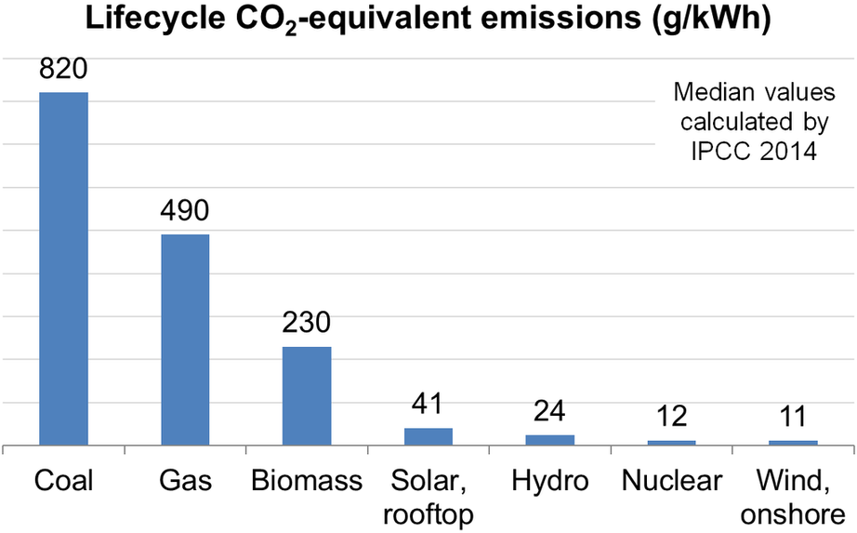
OBJECTIVES
Determine Optimal Tilt Angles
Use code to determine the optimal tilt angles for solar panels in various Indian climatic zones to maximize solar energy absorption.
Reduce Carbon Footprint
Provide data-driven recommendations to improve the efficiency of solar energy systems based on location-specific parameters.
Optimize Installation Area
Develop a code-based approach to calculate the optimal installation area for solar panels, ensuring maximum energy generation.
Maximize Cost Savings
Contribute to sustainable energy solutions by optimizing solar power generation across diverse environmental conditions in India.
Apply ASHRAE Model
Leverage the ASHRAE model to accurately assess direct, diffuse, and reflected solar radiation for different regions.

Slide 4
METHODOLOGY
Conduct a comprehensive review of existing studies on solar radiation, tilt angles, and installation area optimization.
Use coding and the ASHRAE model to compute optimal tilt angles for solar panels based on solar radiation data.
Develop and apply a code-based approach to determine the optimal installation area for maximizing solar energy generation.
Literature Review
Data Collection
Tilt Angle Calculation
Model Validation
Installation Area Calculation
Gather climatic data, solar radiation levels, and geographical information for different zones in India.
Validate the calculated tilt angles using simulations and compare them with existing models for accuracy.

Slide 5
LITERATURE REVIEW
Sl. No. | Title | Authors | Important Outcomes
01 | Comparison of solar radiation models and their validation under Algerian climate - The case of direct irradiance | Behar O, Khellaf A, Mohammedi K. | ASHRAE model provides highly accurate DNI estimates, outperforming other models.
02 | Adjustment factorsfor the ASHRAE clearsky model based on solar-radiation measurements in Riyadh | Al-Sanea SA, Zedan MF, Al-Ajlan SA | Applying regional correction factors to ASHRAE improves accuracy for locations like Riyadh.
03 | Estimation of clear-sky solar radiation using ASHRAE model for Aligarh, India Solar Energy View project Energy Systems Planning and Operation under High Penetration of Renewable Energy Sources Using ASHRAEModel for Aligarh, India | Jamil B, Khan MM, Maroof Khan M. | ASHRAE is effective for evaluating solar radiation on various surfaces and components.
04 | Computing global and diffuse solar hourly irradiation on clear sky. Review and testing of 54 models | Badescu V, Gueymard CA, Cheval S, Oprea C, Baciu M, Dumitrescu A, et al | ASHRAE is among the top models for diffuse radiation, though no single model is universally optimal.

Slide 6
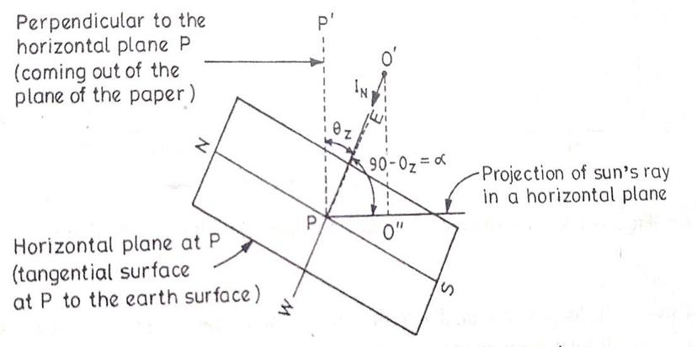
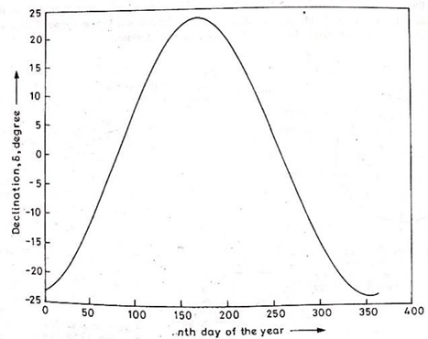
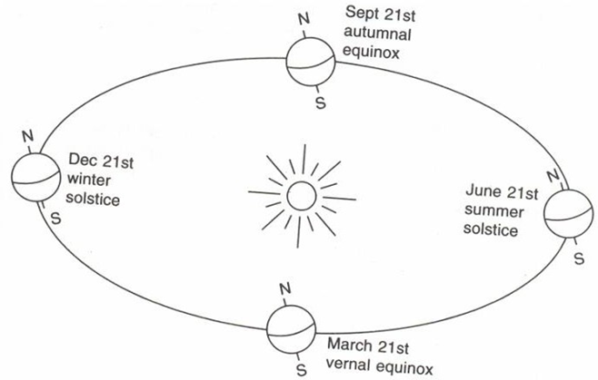
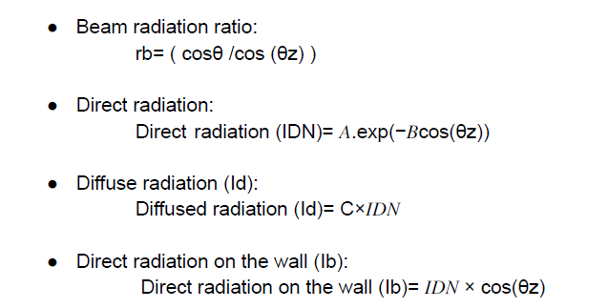
THEORETICAL CONCEPTS USED
Zenith Angle
Decilnation Angle Vs Day Number
Solar Geometry

Slide 7

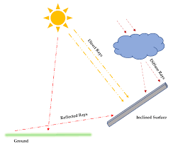

VALIDATION
Comparison with Actual Data: Solar energy outputs & optimal tilt angles validated using real-world solar radiation datasets.
Error Analysis: Differences b/w predicted & observed solar irradiation values were minimal (<5%)
Consistency Across Seasons: Variations in solar output due to tilt adjustments were consistent with theoretical expectations.
Started initial coding for calculating installation areas based on optimized tilt angles.
~ Source: Center for Policy Research | NITI Aayog Energy India

Slide 8
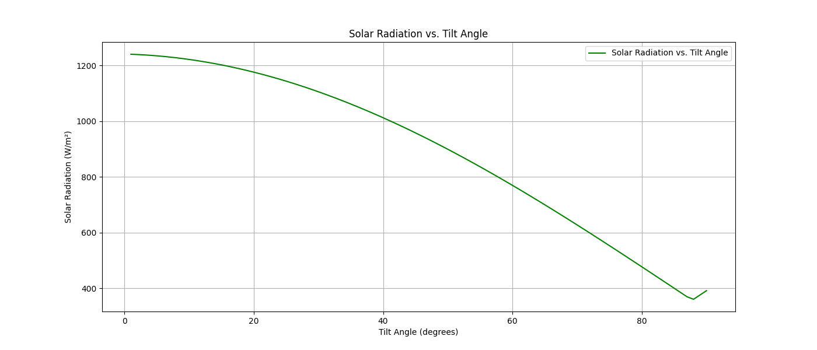
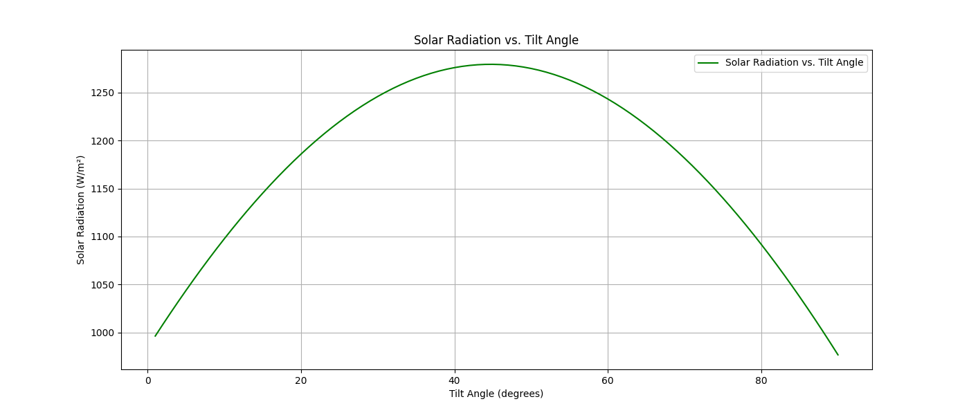
For Summer Season - Raipur
RESULTS AND CONCLUSION
The project focuses on optimizing solar panel installations for better energy generation across diverse climates in India.
Using the ASHRAE model, we calculated optimal tilt angles and installation areas for different regions.
For Winter Season - Raipur
Results indicate significant variation in solar radiation across cities, stressing the need for tailored strategies.
This research aids in maximizing solar energy capture, promoting sustainable energy use, and reducing reliance on non-renewable sources.

Slide 9

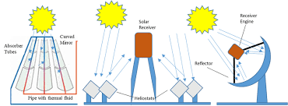
FUTURE WORK & APPLICATIONS
Expand the model to include different types of buildings beyond HIG houses.
Calculations for:
Government buildings
Corporate Houses
Integrate real-time weather data for dynamic optimization of solar panel configurations.
Dynamic tilting solar panel for optimal tilt angle
Application of findings in government policy-making and urban planning for sustainable energy solutions.

Slide 10
REFERENCE
Behar O, Khellaf A, Mohammedi K. A comparison of solar radiation models and their validation for the Algerian climate - focusing on direct irradiance. Energy Convers Manag. 2015 Jul 1;98:236–51.
Al-Sanea SA, Zedan MF, Al-Ajlan SA. Adjustments for the ASHRAE clear-sky model based on solar-radiation data in Riyadh. Appl Energy. 2004;79(2):215–37.
Tiwari GN. Solar Energy Fundamentals, Design, Modelling and Applications, Revised Edition, Narosa Publication House, New Delhi. 2002.
Centre for Policy Research (CPR): Trends in India’s Residential Electricity Consumption (NITI Aayog India Energy). Available at: https://cprindia.org/trends-in-indias-residential-electricity-consumption/
e-websites https://nptel.ac.in/courses/112105129
Housing Board Project List. Available at: https://cghb.gov.in/project-list.html
Resolution: To overcome these challenges, we validated data sources, adapted the model, employed advanced data integration techniques, and rigorously tested the code to ensure accuracy and reliability.

Slide 11

THANK YOU

